Slide 1
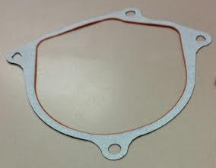
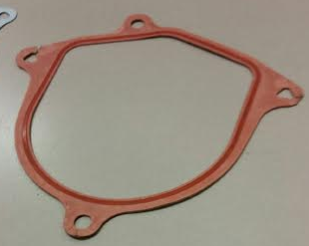
RCM-92: Alternative Sealing Methods (Dry)
Last updated: 26JA15
Description
Paper gaskets and cure in place seals
Motivation : XX
Deliverables
Robust methods for sealing and rework able
Lower cost solution
Timing
Proven it will seal in correct application
Cost is in line with other methods.
Team Members/Customers
Team names Jeff Krueger Kevin McClendon
Customers: Applications group

Slide 2
XCM-xx: Issue Name
Last updated: 26JA15
Status Update:
Tested on BMW MCV and UKL programs
Did seal the motor to assist mech joint
Cost was slightly higher then current wet seal
Did component level testing and pasted water intrusion testing
Have detailed FEA results
Challenges:
Cost
Finding an application
Next Actions:
Waiting for a program

